Slide 1
Node.js
3APIS

Slide 2
3APIS – Node.js
Course Objectives
By the end of the course, students should:
Understand how Node.js is different
Know about npm
Be able to use Node.js APIs
Work around native function
Create a basic webserver
Time:
course: 4h
exercises: 3h

Slide 3
Summary
Node.js concepts
Node Package Manager
Using Node.js
Internal libraries
Webserver

Slide 4
1. Node.js concepts

Slide 5
1. Node.js concepts
Node.js was created by Ryan Dahl, a software engineer, and it was introduced to the world in 2009.
The main idea behind Node.js was to provide a runtime environment that allows developers to execute JavaScript code on the server side, extending the language's capabilities beyond the confines of the browser.

Slide 6
1. Node.js concepts
Ryan Dahl's motivation for creating Node.js stemmed from the limitations of traditional server-side technologies at the time.
Conventional server-side environments, characterized by synchronous, blocking I/O operations, faced challenges in handling a large number of concurrent connections efficiently.
Dahl envisioned a new approach, one that embraced an event-driven, non-blocking model, optimizing performance and enabling the development of scalable and real-time applications.

Slide 7
1. Node.js concepts
Non-Blocking I/O
Node.js employs an asynchronous, non-blocking I/O model, allowing it to handle multiple requests simultaneously without waiting for each operation to complete before moving on to the next.

Slide 8
1. Node.js concepts
Event-Driven Architecture
Node.js follows an event-driven architecture where actions or events trigger responses.
This approach is well-suited for scenarios where responsiveness and real-time updates are critical.

Slide 9
1. Node.js concepts
JavaScript on the Server
Node.js unifies JavaScript development by enabling the use of the same language on both the client and server sides.
This allows developers to seamlessly transition between frontend and backend development, promoting code reuse and a more cohesive development experience.

Slide 10
1. Node.js concepts
At its core, Node.js is not just a runtime environment; it represents a paradigm shift in how we conceive and build server-side applications.
Unlike traditional server-side technologies that follow a synchronous, blocking I/O model, Node.js adopts an event-driven, non-blocking approach.
This unique architecture allows developers to handle multiple concurrent connections efficiently, making Node.js particularly adept at building real-time applications and high-performance web servers.

Slide 11
1. Node.js concepts
Powered by the V8 JavaScript engine from Google, Node.js executes JavaScript code server-side, a departure from its conventional role confined to the browser.
This unification of JavaScript across the entire development stack, commonly referred to as "JavaScript everywhere," brings a harmonious synergy to the world of full-stack development.
Developers can seamlessly transfer their skills from frontend to backend, fostering code reusability and creating a more unified and streamlined development experience.

Slide 12
1. Node.js concepts
One of Node.js's standout features is its ability to handle asynchronous operations efficiently.
This characteristic is particularly advantageous in scenarios where real-time updates and responsiveness are paramount, such as in chat applications, online gaming platforms, and collaborative tools.
Node.js empowers developers to create applications that not only meet but exceed user expectations in terms of speed and interactivity.

Slide 13
1. Node.js concepts
As we embark on this exploration of Node.js, we'll delve into its key features, advantages, and use cases that have propelled it to the forefront of web development.
Whether you're a seasoned developer or just stepping into the world of server-side JavaScript, Node.js invites you to embrace a paradigm that has reshaped the landscape of backend development.

Slide 14
1. Node.js concepts
As for governance, the Node.js project is now governed by the Node.js Foundation, which was established to manage the development and direction of the project.
The foundation serves as a neutral and collaborative forum where contributors, stakeholders, and users can work together to ensure the continued growth and stability of Node.js.
In 2019, the Node.js Foundation merged with the JavaScript Foundation to form the OpenJS Foundation. This consolidation brought together a broader ecosystem of JavaScript projects, fostering collaboration and resource-sharing among various initiatives.

Slide 15
1. Node.js concepts
Today, Node.js continues to evolve under the auspices of the OpenJS Foundation. The project is managed by a Technical Steering Committee (TSC), which is responsible for overseeing the technical direction and decisions related to Node.js development.
This collaborative and community-driven governance structure ensures that Node.js remains an open and inclusive platform, welcoming contributions from developers worldwide.

Slide 16
1. Node.js concepts
Node.js' evolution is marked by a commitment to staying at the forefront of web development.
Regular releases introduce new features, performance enhancements, and improvements, keeping pace with the evolving needs of developers and the demands of modern applications.
The community-driven nature of Node.js, coupled with its strong governance, positions it as a dynamic and innovative platform that continues to shape the landscape of server-side JavaScript development.

Slide 17

Exercises

Slide 18
2. Node Package Manager

Slide 19
2. Node Package Manager
Node Package Manager (NPM) is another integral aspect of the Node.js ecosystem.
With a vast repository of over a million packages, NPM has become the go-to resource for developers seeking reusable libraries and tools.
This thriving ecosystem, coupled with the ease of package installation and version management, empowers developers to accelerate their projects and collaborate on a global scale.

Slide 20
2. Node Package Manager
NPM, or Node Package Manager, stands as a pivotal component within the Node.js ecosystem, serving as the primary package manager for JavaScript runtime.
It was created by Isaac Z. Schlueter and initially released in January 2010. The introduction of NPM marked a transformative moment in the development of Node.js applications, providing a centralized repository for sharing, discovering, and managing JavaScript packages.

Slide 21
2. Node Package Manager
Isaac's vision was to establish a robust and efficient system for handling dependencies in Node.js projects.
NPM not only streamlined the process of installing and managing libraries but also facilitated version control, enabling developers to specify and control the exact versions of packages required for their projects.

Slide 22
2. Node Package Manager
One of the notable features of NPM is its expansive and diverse registry.
The NPM registry hosts a vast collection of open-source packages, allowing developers to leverage pre-built modules for common functionalities, significantly accelerating the development process.
This extensive ecosystem has played a crucial role in the widespread adoption of Node.js, fostering a collaborative environment where developers can share and contribute to the community.

Slide 23
2. Node Package Manager
In 2020, GitHub, a prominent platform for version control and collaborative software development, acquired NPM Inc., the company behind NPM.
This acquisition aimed to integrate NPM more closely with GitHub, creating a seamless experience for developers by combining the strengths of both platforms.
GitHub's ownership of NPM has reinforced the commitment to the sustainability and security of the JavaScript ecosystem, as well as enhancing the overall developer experience.

Slide 24
2. Node Package Manager
The acquisition of NPM by GitHub was preceded by Microsoft's acquisition of GitHub in 2018, further emphasizing the industry's recognition of the importance of these tools in modern software development.
The collaboration between GitHub and NPM has brought about improvements in the areas of security auditing, package discovery, and overall user experience within the JavaScript community.

Slide 25
2. Node Package Manager
NPM has played a pivotal role in shaping the Node.js ecosystem, offering a centralized hub for package management and contributing to the efficiency and scalability of JavaScript development.
Its journey from creation by Isaac Z. Schlueter to being acquired by GitHub underscores its significance in the broader landscape of modern software development.
The collaboration between NPM and GitHub continues to enhance the developer experience, reinforcing their commitment to the growth and sustainability of the JavaScript ecosystem.

Slide 26
2. Node Package Manager
NPM is a command-line tool and the default package manager for Node.js. It plays a crucial role in simplifying the process of managing and sharing JavaScript code and libraries.
Developers use NPM to install, manage, and distribute packages, which are reusable modules of code that can be easily integrated into projects.
These packages can range from utility functions and frameworks to entire applications, making NPM a fundamental tool for JavaScript developers.

Slide 27
2. Node Package Manager
Installing Packages
To install a package using NPM, developers use the npm install command followed by the package name.
For example, to install the popular utility library lodash, the command would be:
> npm install react
This fetches the lodash package from the NPM registry and installs it locally within the project.

Slide 28
2. Node Package Manager
Managing Dependencies
NPM maintains a package.json file in the root of a project to manage dependencies. This file lists all the dependencies, including their versions, required for the project. Developers can install all dependencies listed in the package.json file using:
> npm install

Slide 29

2. Node Package Manager
Managing Dependencies
Additionally, developers can save a package as a dependency using the --save flag to update the package.json file - or using the --save-dev flag to save a dev dependency
> npm install react --save
> npm install mocha --save-dev

Slide 30
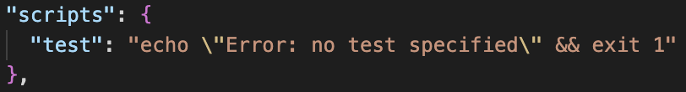
2. Node Package Manager
Executing Scripts
NPM allows developers to define and run scripts in the package.json file.
This is commonly used for tasks such as running tests, building the project, or starting the application. For example, a script to start a server could be defined in the package.json file:

Slide 31
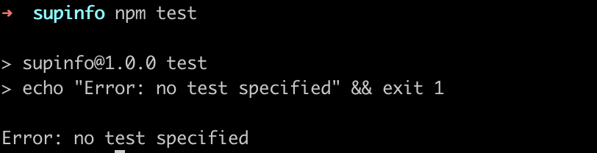
2. Node Package Manager
Executing Scripts
Running the script is done with:
> npm test

Slide 32
2. Node Package Manager
Global Packages
Some packages are meant to be installed globally and used as command-line tools. The -g flag is used for global installations. For instance, to install the Node.js debugging tool, nodemon, globally:
> npm install -g nodemon
This allows the nodemon command to be accessible from any terminal window.

Slide 33
2. Node Package Manager
Publishing Packages
NPM enables developers to share their own packages with the global community. By creating a package.json file and using the npm publish command, developers can publish their packages to the NPM registry for others to use.
> npm publish

Slide 34
2. Node Package Manager
These examples highlight the versatility of NPM in managing project dependencies, running scripts, and sharing code with other developers.
As a fundamental tool in the Node.js ecosystem, NPM greatly contributes to the efficiency and collaborative nature of JavaScript development.
This is mostly thanks to the file “package.json”

Slide 35
2. Node Package Manager
The package.json file is a crucial component in Node.js projects, serving as a configuration file that contains metadata and essential information about the project.
This JSON-formatted file is not only a central reference for project configuration but also plays a pivotal role in managing dependencies, scripts, and project-related details.

Slide 36
2. Node Package Manager
At its core, package.json includes fundamental project information such as the project's name and version, following the principles of semantic versioning (SemVer).
This metadata is essential for understanding the identity and versioning of the project, facilitating collaboration and coordination among developers.

Slide 37
2. Node Package Manager
The file provides a structured way to declare project dependencies.
Within the dependencies section, developers specify the external libraries or modules required for the project to function properly.
These dependencies can be installed automatically using package managers like npm based on the information provided in the package.json file.

Slide 38
2. Node Package Manager
For developers engaging in project development and testing, package.json introduces the concept of devDependencies.
This section lists dependencies that are necessary during the development phase but not required for the production environment.
This separation ensures that production environments remain lean and only include dependencies essential for runtime.

Slide 39
2. Node Package Manager
One of the notable features of package.json is the inclusion of scripts.
The scripts section allows developers to define custom commands that can be executed via npm.
Common scripts include starting the application, running tests, or executing build processes. This capability simplifies complex workflows and standardizes project-related tasks.

Slide 40
2. Node Package Manager
Beyond technical details, package.json includes metadata about the project, such as the project's author, licensing information, and a brief description.
This metadata provides context and aids in project documentation, making it easier for developers, collaborators, and users to understand the project's purpose and attributes.

Slide 41
2. Node Package Manager
Additionally, the package.json file allows developers to specify the minimum version of Node.js and npm that the project is compatible with.
This ensures that the project is executed in environments that meet the specified criteria, promoting consistency and avoiding compatibility issues.

Slide 42
2. Node Package Manager
In summary, package.json is more than just a configuration file; it's a central hub of information that streamlines project management, fosters collaboration, and ensures a standardized and well-documented development environment in the Node.js ecosystem.
It reflects the best practices of modern software development, providing a comprehensive and structured approach to project configuration and dependency management.

Slide 43
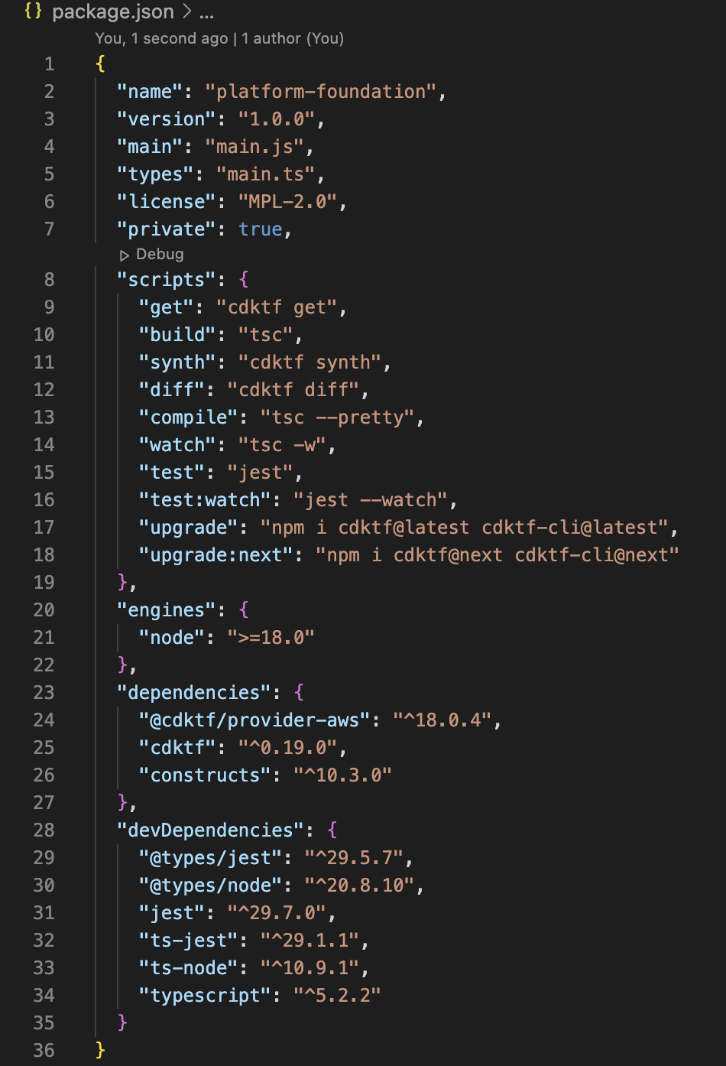
2. Node Package Manager

Slide 44
2. Node Package Manager
In addition to the package.json file, Node.js projects often include a package-lock.json file, which serves a specific purpose in managing package dependencies.
The package-lock.json file is automatically generated and updated by npm to provide a deterministic and reproducible snapshot of the project's dependency tree.

Slide 45
2. Node Package Manager
The primary role of package-lock.json is to lock down the versions of all installed packages, including their dependencies, ensuring that subsequent installations are consistent across different environments.
This file is especially valuable in collaborative development scenarios or when deploying applications to different environments, as it guarantees that all developers and systems use the exact same versions of packages.

Slide 46
2. Node Package Manager
It's important to note that while package-lock.json is automatically generated by npm, developers typically include it in version control systems (e.g., Git) to maintain a consistent environment across development, testing, and production.
However, it's generally recommended not to manually edit the package-lock.json file, as npm manages it automatically based on the package.json file and the state of the installed packages.

Slide 47
2. Node Package Manager
Some specific commands that you can use from npm
npm audit
Performs a security audit on your project's dependencies, identifying any known vulnerabilities.
npm init
Initializes a new package.json file for your project. It prompts you to enter details such as the project name, version, entry point, test command, repository, and more.

Slide 48
2. Node Package Manager
Some specific commands that you can use from npm
npm update
Updates packages to their latest versions based on the version constraints specified in the package.json file.
npm run xyz
Executes a script xyz defined in the scripts section of the package.json file.

Slide 49
2. Node Package Manager
While npm remains the default choice for many Node.js developers, alternative package managers like Yarn and pnpm provide additional options, each with its unique features and advantages.
The choice of which package manager to use often depends on specific project requirements, developer preferences, and the need for specific features such as speed, disk space efficiency, or offline capabilities.
There are a few alternative package managers that offer different features and approaches.

Slide 50
2. Node Package Manager
Yarn
Yarn is a fast, reliable, and secure package manager for JavaScript. It was developed by Facebook and is designed to be a drop-in replacement for npm.
Yarn introduced features like deterministic dependency resolution, parallel downloads, and offline capabilities, addressing some performance and reliability concerns that developers had with npm.

Slide 51
2. Node Package Manager
pnpm
pnpm is a fast and disk-space efficient package manager for Node.js.
It is designed to share dependencies across projects, saving disk space and reducing redundancy.
pnpm uses a single content-addressable storage for all dependencies, allowing them to be linked and shared.

Slide 52
Exercises

Slide 53
3. Using Node.js

Slide 54
3. Using Node.js
We said that Node.js is different from other languages, but what does it mean exactly? What this idea of event-driven, eventloop or asynchronous I/O can help us?
“
JavaScript has certain characteristics that make it very different than
other dynamic languages, namely that it has no concept of threads. Its
model of concurrency is completely based around events.
“
Ryan Dahl, creator of Node.js

Slide 55
3. Using Node.js
Retrieve all the articles from a Database
Display them
Do something else…
In that example, the program is blocked until the DB return the query result
It is called a blocking I/O operation

Slide 56
3. Using Node.js
Retrieve all the articles from a Database
When complete, display them
Do something else...
In that example, only the second instruction will wait the first one to finish

Slide 57
3. Using Node.js
The event loop is what allows Node.js to perform non-blocking I/O operations despite the fact that JavaScript is single-threaded by offloading operations to the system kernel whenever possible.
Node.js applications are event-driven, meaning they respond to events by executing callback functions. The event loop is responsible for managing and dispatching these events in a non-blocking manner.

Slide 58
3. Using Node.js
The Node.js event loop is a foundational concept in the design of Node.js, playing a central role in its asynchronous, non-blocking I/O model.
At its core, the event loop is a mechanism that enables Node.js to handle multiple operations concurrently without relying on additional threads.
The asynchronous nature of Node.js applications is rooted in the event loop, which manages and dispatches events in a non-blocking manner.

Slide 59
3. Using Node.js
Node.js follows a non-blocking I/O model, allowing the application to continue executing tasks while waiting for I/O operations to complete.
This is achieved through the use of callbacks and the event loop. When an asynchronous operation finishes, its corresponding callback is added to the event queue, and the event loop schedules its execution.

Slide 60
3. Using Node.js
The benefits of the event loop in Node.js are significant. It contributes to the scalability of Node.js applications, enabling them to handle numerous concurrent connections without the need for threading.
The non-blocking I/O operations enhance efficiency by preventing the application from idling during I/O waits.
Moreover, the event-driven model makes Node.js highly responsive to events, making it suitable for real-time applications such as chat systems or online gaming.

Slide 61
3. Using Node.js
A thorough understanding of the Node.js event loop is essential for developing performant and scalable applications.
It forms the core of Node.js' ability to handle concurrent connections while maintaining responsiveness and low latency, enabling developers to create efficient server-side applications.

Slide 62
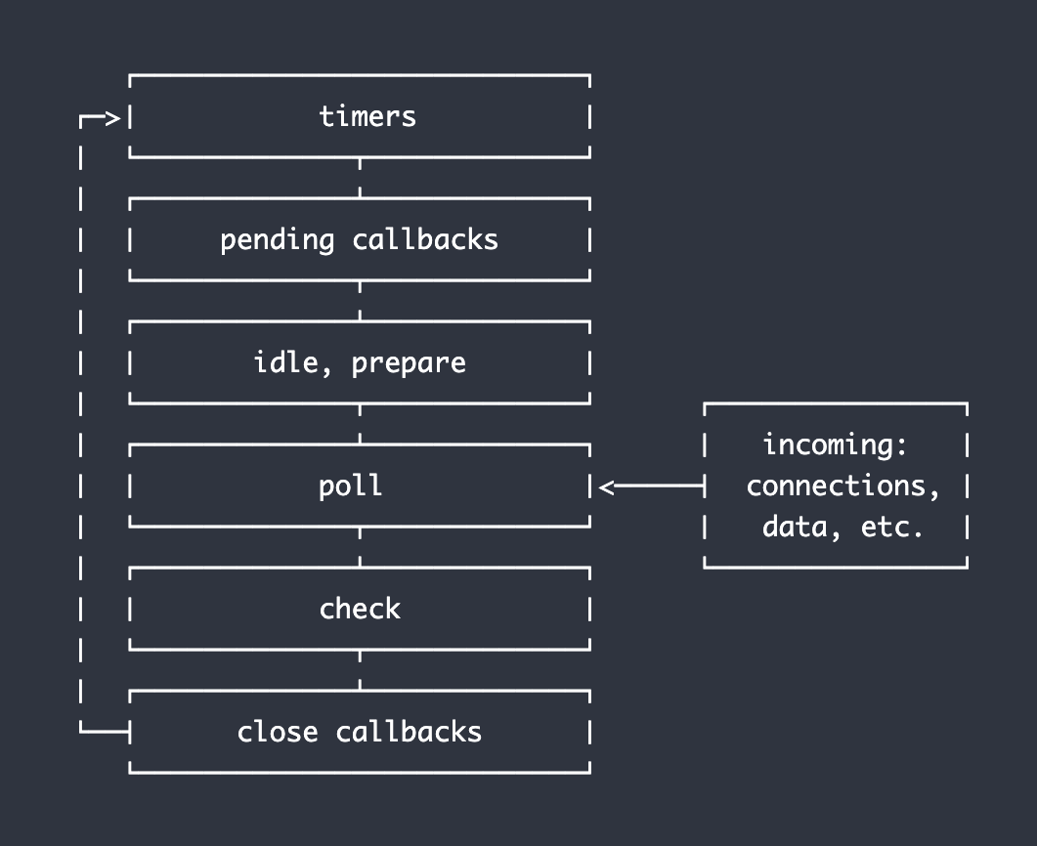
3. Using Node.js
Documentation
Node.js EventLoop schema

Slide 63
3. Using Node.js
The event-driven architecture in Node.js is facilitated by the event loop, which efficiently manages and dispatches events.
Core libraries in Node.js, such as those for file system operations (fs module), networking (http and net modules), and database interactions (mysql or mongodb modules), are crafted to emit events upon completion or in response to certain triggers.
Developers can register event listeners (callbacks) to respond to these events, making it an inherently non-blocking and asynchronous process.

Slide 64
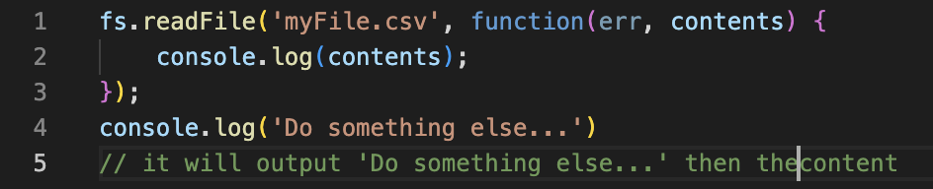
3. Using Node.js
Node.js libraries are designed to be non-blocking
Inside a normal JavaScript file: index.js (extension .js)
To run the previous script, you just need to do “node index.js” (or “node” followed by the name of your file)

Slide 65
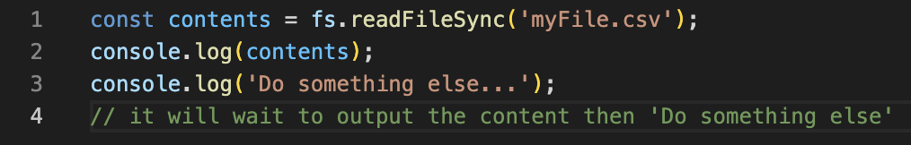
3. Using Node.js
But some libraries also provide a blocking solution
The main difference is that the function “readFile” is now named “readFileSync”. Node.js exposes a function to read a file both in a synchronous and asynchronous way.

Slide 66
3. Using Node.js
One key point to remember Node.js is NOT:
a web framework: do not compare it to Rails (Ruby) or Django (Python) but more to Python or Ruby directly
multi threaded: you can now use WebWorker, but by default it is not a true multithreaded solution

Slide 67
3. Using Node.js
Outside of that Node.js is pretty much compliant with the full JavaScript specification (ECMA).
As you can expect, Node.js being only server side it means that only the features that are not linked to the window, the browser or the graphical interface are availables. You cannot use
all functions related to windows
all features linked to navigator (like gps, camera…)
all solutions to access user system (Node.js run on your server)

Slide 68
3. Using Node.js
Also Node.js use historically the CommonJS specification to create a module or library
But since a couple years you can also create a module with the ESM specification - this one being also the official specification for JavaScript regarding module.
the change between CJS (CommonJS) and ESM (EcmaScript Module) takes time
Node.js v21 now support a flag to invert the default, from CJS to ESM

Slide 69
3. Using Node.js
The two specifications are not fully compatible. As of right now there are still some issues if you try to use both solutions in the same project.
As time passes, more and more libraries and projects migrate to use the “new” standard with ESM. This unfortunately takes some time, especially because
some feature available in CJS are not possible in ESM
you need to rewrite most of your code
libraries author need to support the two versions during the transition

Slide 70
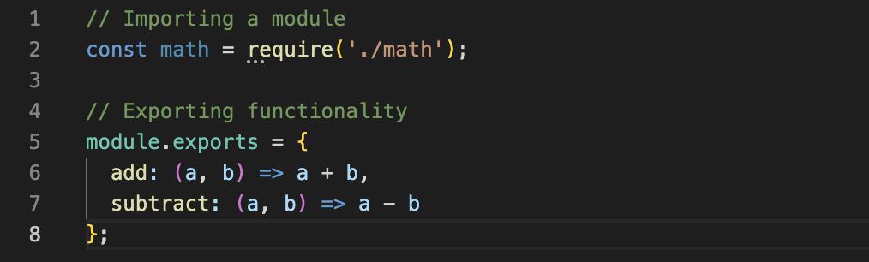
3. Using Node.js
CJS Example

Slide 71
3. Using Node.js
CommonJS is a module system introduced to standardize modular JavaScript code for server-side environments, notably in the Node.js ecosystem.
CommonJS modules use the require function to import modules and module.exports or exports to expose functionality.

Slide 72
3. Using Node.js
One notable characteristic of CommonJS is its synchronous loading of modules. Dependencies are loaded and executed sequentially, making it straightforward to understand the flow of the code.
CommonJS modules were designed with server-side JavaScript environments, like Node.js, in mind. They are well-suited for scenarios where synchronous loading is acceptable.

Slide 73
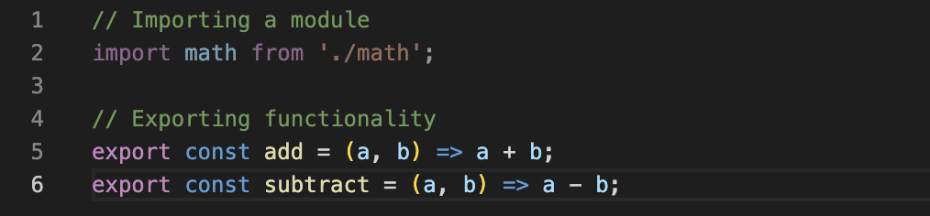
3. Using Node.js
ESM Example

Slide 74
3. Using Node.js
ESM is the native module system introduced in ECMAScript 6 (ES6) and later versions of JavaScript. It is designed to be a more standardized and versatile module system, applicable both in browsers and server-side environments.
ESM uses the import and export keywords for module importing and exporting.
One significant feature of ESM is its support for asynchronous module loading. This enables more dynamic and efficient loading of modules, particularly beneficial in scenarios where dependencies may be loaded asynchronously.

Slide 75
3. Using Node.js
ESM is designed to work seamlessly in both browser and server environments. It is gradually gaining wider adoption, as modern JavaScript runtimes, including Node.js, increasingly support ESM syntax.
ESM supports tree-shaking, a process that eliminates unused code during the bundling phase. This can result in smaller bundle sizes, optimizing the performance of web applications.

Slide 76
3. Using Node.js
If needed, you can tell Node.js to use the ECMAScript modules loader via
the .mjs file extension
the package.json "type" field
the --input-type flag.

Slide 77
3. Using Node.js
Like seen a bit earlier, if you want to run a Node.js script simply execute in your terminal
node /path/to/file
for example: node index.js
You script should be executed. If you want to see some result or values you will need to console.log (or equivalent) to have an output in the stdout stream.
By typing “node” in your terminal, you will directly open the Node.js REPL

Slide 78
3. Using Node.js
Reminder: Node.js builds your code only once when you run your script or a command. If you update your code after running it, it won't be modified or reloaded by the runtime.
You have to relaunch the run command, each time.
You can also use a watcher to automatically reload your code. One working solution is
to use the nodemon package
or use the --watch flag part of Node.js since Node v20

Slide 79

3. Using Node.js
nodemon
To install it you simply need to execute this command
> npm install -g nodemon
The -g will install the package globally and have it available on your whole system. Then replace node by nodemon to run your code
> nodemon index.js

Slide 80
3. Using Node.js
--watch
Since Node.js v20, you can find a feature (still experimental) that replace what nodemon is able to do. The --watch flag allows you to say to your node processus to reload if it detects that a file in the project (or in a specific directory depending on the options) is changed, then it should automatically reload
node --watch index.js
node --watch --watch-preserve-output index.js
node --watch-path=./src index.js

Slide 81
3. Using Node.js
The full documentation is available on the Node.js website
--watch documentation
--watch-preserve-output documentation
--watch-path documentation

Slide 82
Exercises

Slide 83
4. Internal libraries

Slide 84
4. Internal libraries
Passing in arguments via the command line is an extremely basic
programming task, and a necessity for anyone trying to write a simple
Command-Line Interface (CLI).
In Node.js, as in C and many related environments, all command-line
arguments received by the shell are given to the process in an array called argv (short for 'argument values').

Slide 85
4. Internal libraries
Node.js exposes this array for every running process in the form of
process.argv - let's take a look at an example.
Make a file called index.js and add this line:
> console.log(process.argv); Execute your script from your terminal with the arguments you want.

Slide 86
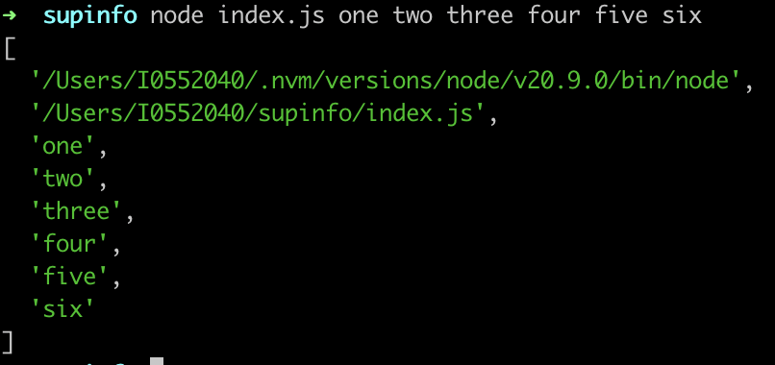
4. Internal libraries
You should obtain something like this

Slide 87
4. Internal libraries
There you have it - an array containing any arguments you passed in. Notice the first two elements - node and the path to your script.
These will always be present - even if your program takes no arguments of its own, your script's interpreter and path are still considered arguments to the shell you're using.

Slide 88
4. Internal libraries
Referring to your command-line arguments by array index isn't very clean, and can quickly turn into a nightmare when you start working with flags and the like
imagine you make a server, and it need a lot of arguments
imagine having to deal with something like
myapp -h host -p port -r -v -b --quiet -x -o outfile
some flags need to know about what comes next, some don't, and most CLIs let users specify arguments in any order they want.
Does that sound like a fun string to parse?

Slide 89
4. Internal libraries
Luckily, there are many third party modules that makes all of this trivial - one of which is yargs. It's available via npm. Use this command from your app's base path:
> npm i yargs
Or since Node.js v18, you can use the parser included inside Node.js
> const { parseArgs } = require('node:util');

Slide 90
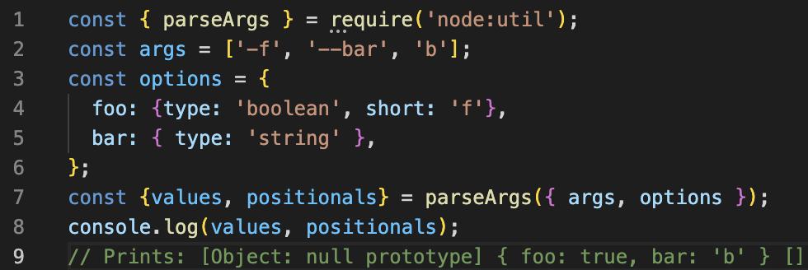
4. Internal libraries
Example from documentation if you call your script with > node index.js -f --bar b

Slide 91
4. Internal libraries
Sometimes while working with Node.js you will need to interact with the system and more specifically with the file system.
You will have to read a file, write it or do others operations.
For that Node.js provides a core module fs which is built to provide all the needed functionalities

Slide 92
4. Internal libraries
First of all you need to require (or import if you use the ESM syntax) the core module.
No need to install it as this is already bundled inside Node.js core
You can now start using it !

Slide 93
4. Internal libraries
To read the content synchronously

Slide 94
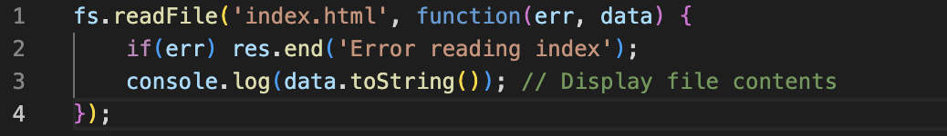
4. Internal libraries
To read the content asynchronously you can either way use the callback
solution

Slide 95
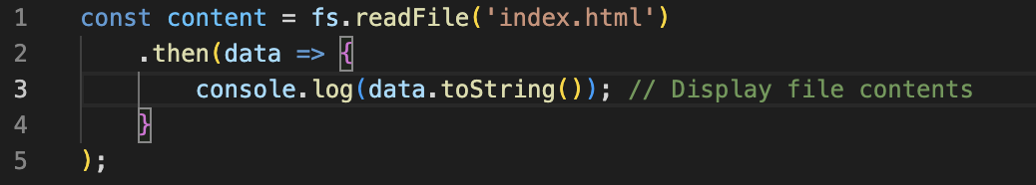
4. Internal libraries
Or the promisified way to to it - depending on which import you used

Slide 96
4. Internal libraries
Or the sugar syntax with async/await

Slide 97
4. Internal libraries
Did you notice the toString() method?
fs reading methods returns a buffer object
toString() returns the actual content

Slide 98
4. Internal libraries
The fs module can also
write file: writeFile and writeFileSync
delete file: unlink and rmdir
rename file: rename and renameSync
change permission: chmod and chown

Slide 99
Exercises

Slide 100
5. Webserver

Slide 101
5. Webserver
Node.js is a powerful runtime environment that enables the execution of JavaScript code on the server side.
One of the common use cases for Node.js is building web servers. Its non-blocking, event-driven architecture makes it well-suited for handling a large number of concurrent connections efficiently.
If you try to run a basic “hello world” page on your own computer, you should be able to reach (using one core) something around 20.000 requests / second.

Slide 102
5. Webserver
Node.js includes a built-in http module that simplifies the creation of HTTP servers

Slide 103
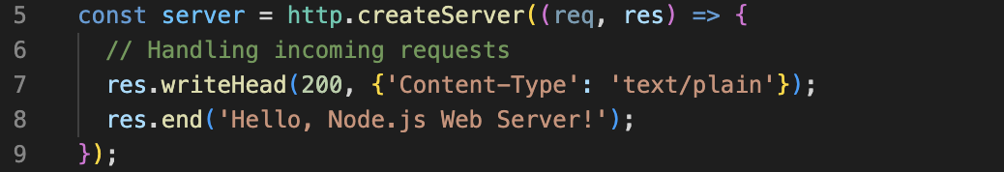
5. Webserver
The createServer method takes a callback function that is invoked for each incoming HTTP request.
Inside the callback, you can handle the request (req) and send a response (res).

Slide 104
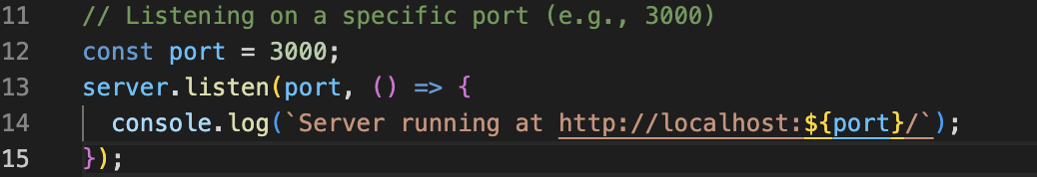
5. Webserver
The listen method specifies the port on which the server should listen for incoming requests.

Slide 105

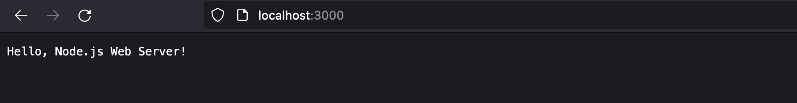
5. Webserver
Open a web browser and navigate to http://localhost:3000/ (or the specified port).
You should see the response message.

Slide 106
5. Webserver
http.ClientRequest
Object created internally by a HTTP server
Represent a client request
Passed as the first argument to a request listener
Contains several useful properties:
headers: HTTP headers
method: Method used (GET, POST, ...)
url: URL given

Slide 107
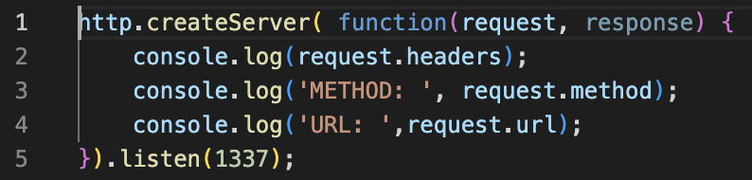
5. Webserver

Slide 108
5. Webserver
http.ServerResponse
Object created internally by a HTTP server
Represent a response that will be send to a client
Passed as the second argument to a request listener
Contains several useful methods:
writeHead: Send HTTP headers to client
write: Send some content
end: Finish response

Slide 109
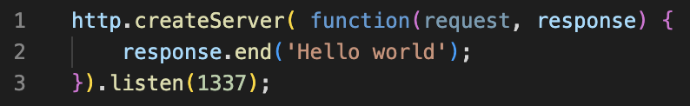
5. Webserver

Slide 110
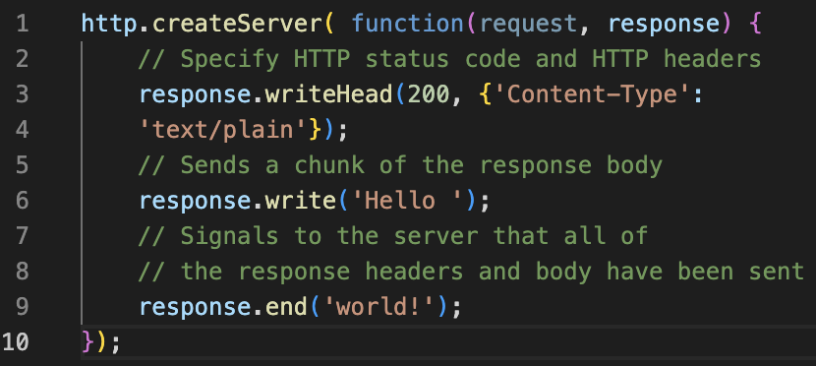
5. Webserver
An example that links and use both functions, as expected in a normal use case when you do create a server.

Slide 111
5. Webserver
The ClientRequest fires event when receiving information. Sometimes you will want to listen to them to handles specific tasks
Allow more control request handling
Based on the on() function
Two most important events are data and end

Slide 112
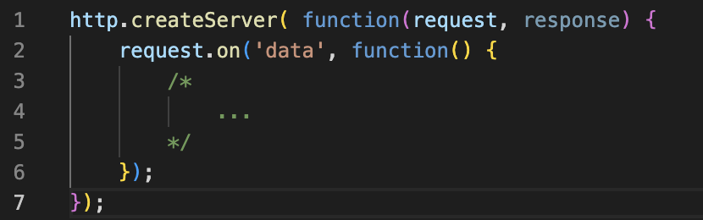
5. Webserver
For example, if you want to react to each chunk of data that are sent by the client, you can easily do that thanks to the event

Slide 113
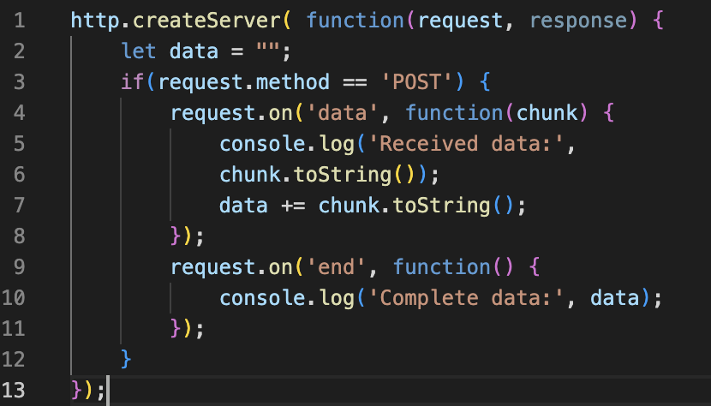
5. Webserver
A bit more complexe, but if you want to handle a POST request with element inside the body you need to listen to each chunk of the message send (a body it not send at once when working with HTTP)

Slide 114
5. Webserver
Tips: response.end() accepts a Buffer as parameter. Which mean that
you can link it to the value returned by the readFile function

Slide 115
5. Webserver
For now you are handling the request manually. It is quite tedious to do so and not really optimized.
Node.js provides a module to work with URLs namely the url module -
present as fs in Node.js core.
The url module in Node.js provides utilities for URL parsing and formatting. It allows you to work with URLs, dissect their components, and construct or modify URLs easily.

Slide 116
5. Webserver
The url module in Node.js simplifies URL manipulation by providing a consistent and convenient API for working with URLs.
Whether parsing, formatting, or resolving URLs, the url module is a valuable tool for developers working with web-related functionalities in their Node.js applications.
Some useful functions from the url module
parse()
search()
new URL()

Slide 117
5. Webserver
The objects returned by url.parse() or accepted by url.format() include the following components:
protocol: The protocol (e.g., 'http:', 'https:').
slashes: A boolean indicating whether the protocol is followed by double slashes ('//').
auth: Authentication information in the form 'username:password'.
host: The full host portion (including hostname and port).
hostname: The hostname.
port: The port, if specified.
pathname: The path portion of the URL.
search: The query string, including the leading '?'.
query: An object representing the query string parameters.
hash: The URL fragment identifier, including the leading '#'.

Slide 118
5. Webserver
Of course, Node.js being built on top of v8 and JavaScript, almost everything you know about the it can be reused in Node.js. This is the same language, with some small differences as it does not run in a browser but a server
some functions are added like readFile or writeFile
some functions are removed like navigator
But all loops, conditions, promises, classes and more are still the same!

Slide 119
Exercises

